Slide 1
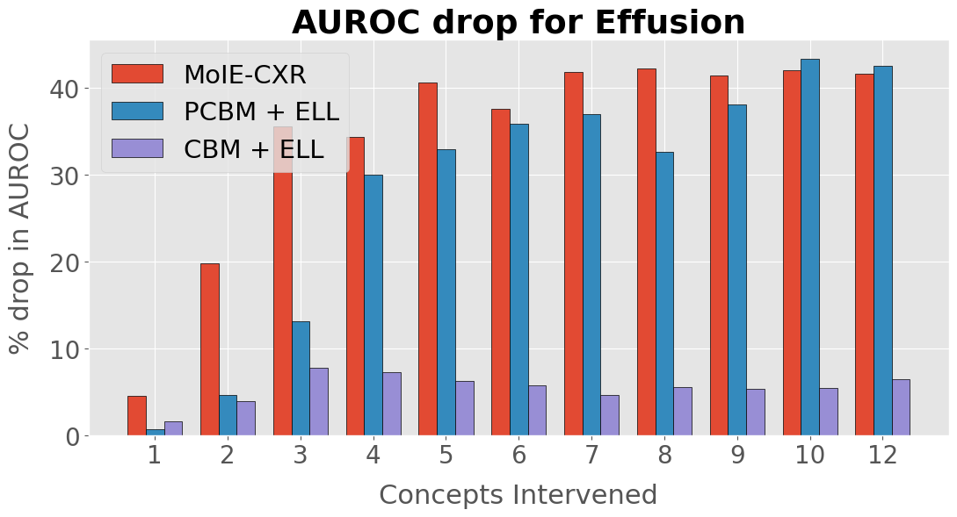
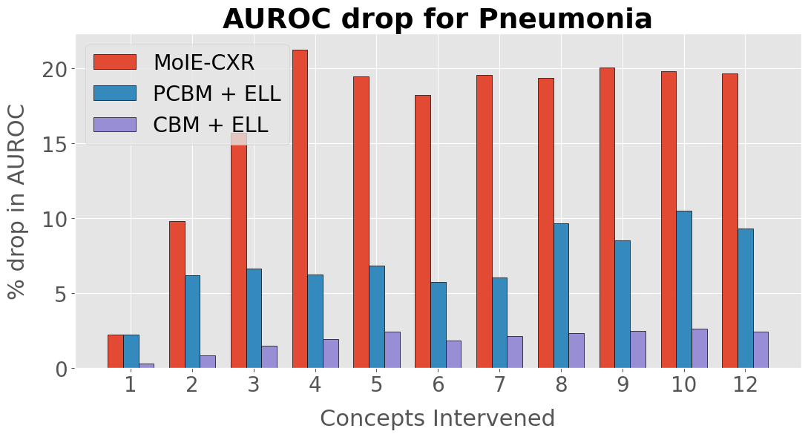
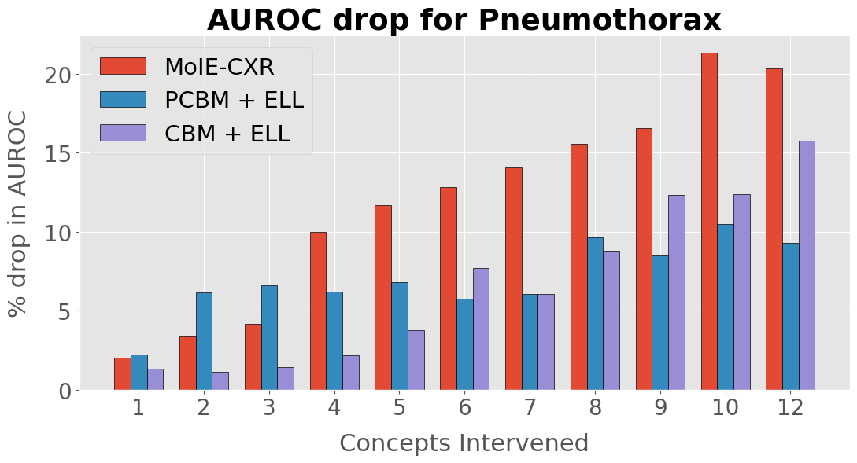
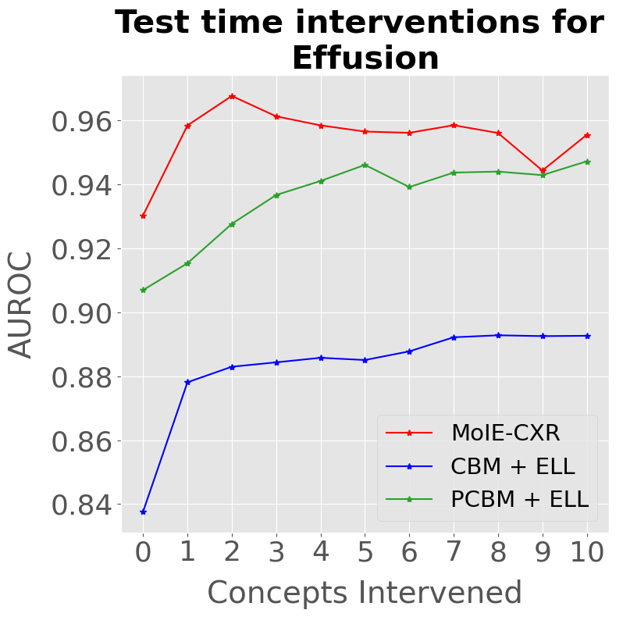
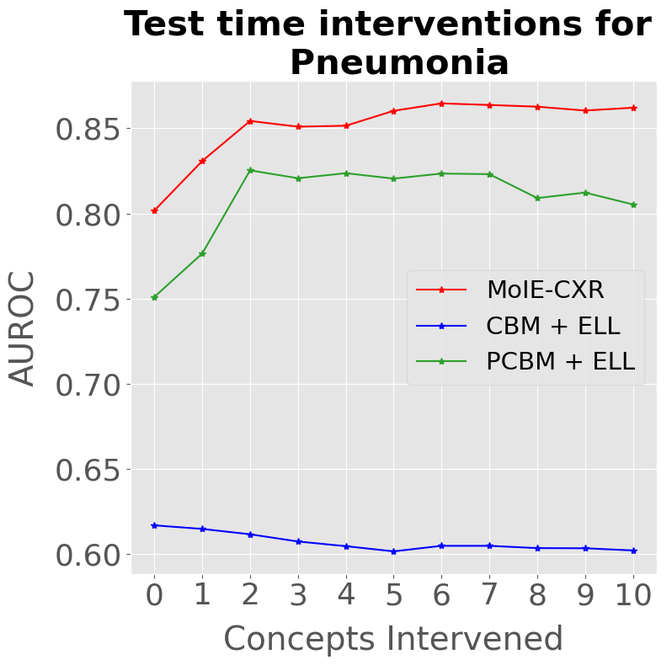
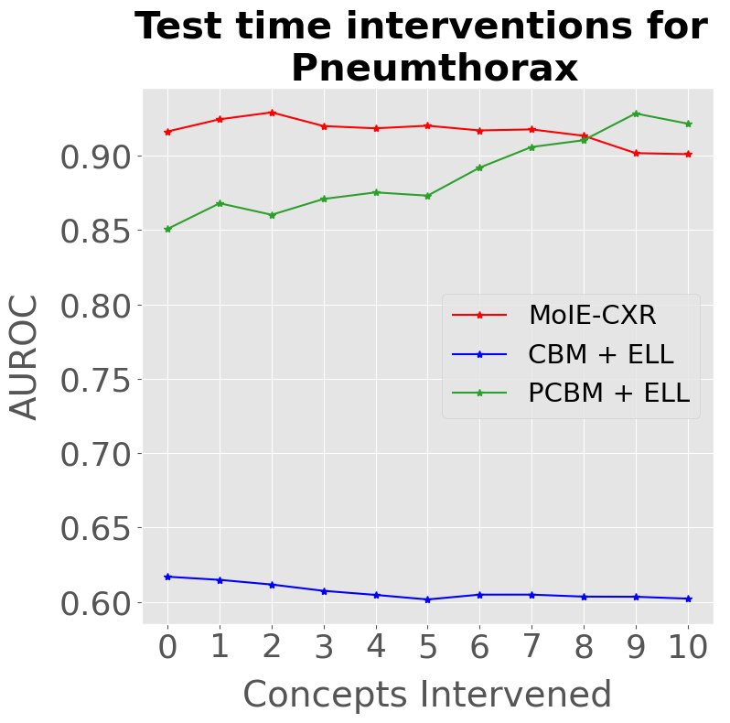
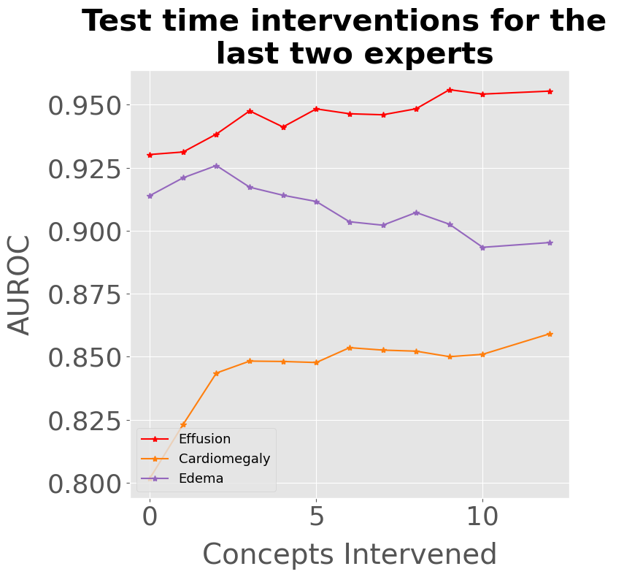
(a)
(b)
(c)
(d)
(e)
(f)
(g)

Slide 2
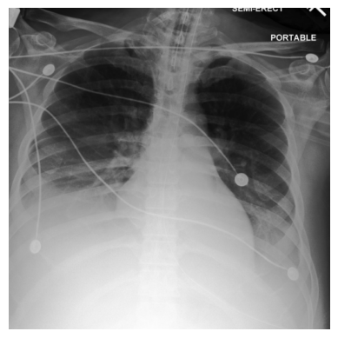
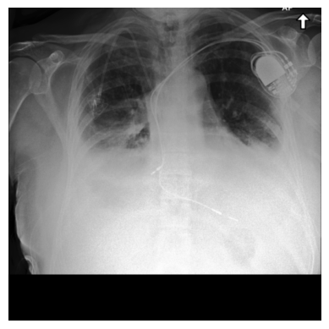
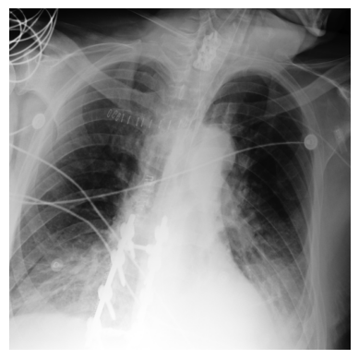
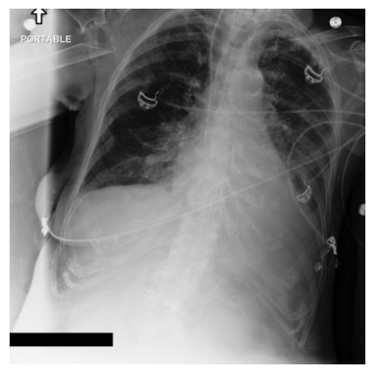
MOIE
Expert1
Expert2
Expert3
Expert4
EFFUSION
CBM + ELL
PCBM + ELL
Notes:
\usepackage[dvipsnames]{xcolor}
align text
% Effusion
% PCBM
\textbf{Effusion} $\leftrightarrow$ {left\_pleural} $\land$ {pleural\_unspec}
%CBM
\textbf{Effusion} $\leftrightarrow$ \big(collapse $\land$ drainage $\land$ left\_pleural $\land$ pleural\_unpec $\land$ right\_diaphragm $\land$ right\_plural $\land\neg$crowd $\land\neg$ low $\land\neg$ right\_ventricle \big) $\lor$ \big(collapse $\land$ crowd $\land$ drainage $\land$ left\_pleural $\land$ low $\land$ pleural\_unpec $\land$ right\_apical\_lung $\land$ right\_diaphragm $\land$ right\_pleural $\land$ right\_ventricle \big)
% Expert 1
&\text{\textbf{Effusion}} \leftrightarrow \text{left\_pleural} \\
&\land \text{right\_pleural} \\
&\land \text{pleural\_unspec}
% Expert 2
&\text{\textbf{Effusion}} \leftrightarrow \text{right\_pleural} \\
&\land \text{pleural\_unspec}
% Expert 3
&\text{\textbf{Effusion}} \leftrightarrow \text{left\_pleural} \\
&\land \text{pleural\_unspec}
% Expert 4
\textbf{Effusion} $\leftrightarrow$ pleural\_unspec

Slide 3
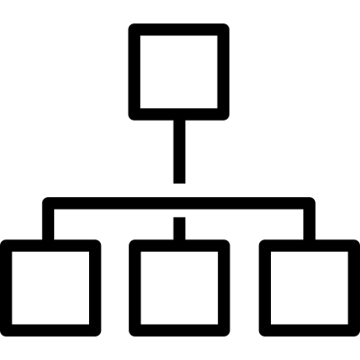
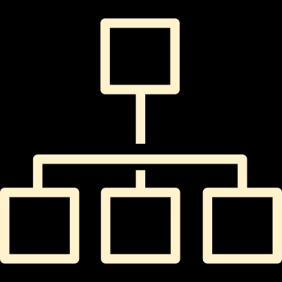
Notes:
\usepackage[dvipsnames]{xcolor}
%Expert 1
\textbf{BayBreastedWarbler} $\leftrightarrow$ \big(\textcolor{blue}{back\_pattern\_striped} $\land$ upperparts\_color\_black $\land$ \textcolor{BrickRed}{wing\_color\_white} $\land$ $\neg$ \textcolor{BrickRed}{nape\_color\_grey} $\land$ $\neg$ throat\_color\_black \big)
$\boldsymbol{\lor}$
\big(belly\_pattern\_solid $\land$ forehead\_color\_black $\land$ \textcolor{BrickRed}{shape\_perchinglike} $\land$ upperparts\_color\_black $\land$ \textcolor{BrickRed}{wing\_color\_white} $\land$ $\neg$\textcolor{BrickRed}{nape\_color\_grey} $\land$
$\neg$\textcolor{BrickRed}{primary\_color\_black} $\land$ $\neg$primary\_color\_white $\land$ $\neg$throat\_color\_black $\land$ $\neg$\textcolor{BrickRed}{under\_tail\_color\_black}\big)
% Expert 2
\textbf{BayBreastedWarbler} $\leftrightarrow$ \textcolor{blue}{back\_pattern\_striped} $\land$ bill\_shape\_allpurpose $\land$ \textcolor{BrickRed}{shape\_perchinglike} $\land$ \textcolor{BrickRed}{wing\_color\_white} $\land$ $\neg$back\_pattern\_multicolored $\land$ $\neg$nape\_color\_black $\land$ $\neg$ nape\_color\_blue $\land$ $\neg$\textcolor{BrickRed}{nape\_color\_grey} $\land$ $\neg$ \textcolor{BrickRed}{primary\_color\_black} $\land$ $\neg$ primary\_color\_grey $\land$ $\neg$\textcolor{BrickRed}{under\_tail\_color\_black}
\text{\textbf{BayBreastedWarbler}} \leftrightarrow & \text{\textcolor{blue}{back\_pattern\_striped}} \hspace{2pt} \land\\
& \text{leg\_color\_grey}
%&\text{\textbf{BayBreastedWarbler}} \\
%&\qquad \qquad \updownarrow \\
%&\text{\textcolor{blue}{back\_pattern\_striped}} \hspace{2pt}\land \\
%&\text{leg\_color\_grey}
% Baseline CBM
%\textbf{BayBreastedWarbler} $\leftrightarrow$ forehead\_color\_black $\land$ leg\_color\_grey $\land$ upper\_tail\_color\_grey $\land$ upperparts\_color\_white
& \quad \qquad \quad \quad \text{\textbf{BayBreastedWarbler}} \leftrightarrow \text{forehead\_color\_black} \hspace{2pt} \land \\
& \qquad \qquad \quad \text{leg\_color\_grey} \hspace{2pt} \land \text{upper\_tail\_color\_grey } \hspace{2pt} \land \\
& \qquad \qquad \quad \text{upperparts\_color\_white}

Slide 4
CBM + ELL
PCBM + ELL
Expert1
Expert2
Expert3
Expert4
Notes:
\usepackage[dvipsnames]{xcolor}
align text
% Effusion
% PCBM
\textbf{Effusion} $\leftrightarrow$ {left\_pleural} $\land$ {pleural\_unspec}
%CBM
\textbf{Effusion} $\leftrightarrow$ \big(collapse $\land$ drainage $\land$ left\_pleural $\land$ pleural\_unpec $\land$ right\_diaphragm $\land$ right\_plural $\land\neg$crowd $\land\neg$ low $\land\neg$ right\_ventricle \big) $\lor$ \big(collapse $\land$ crowd $\land$ drainage $\land$ left\_pleural $\land$ low $\land$ pleural\_unpec $\land$ right\_apical\_lung $\land$ right\_diaphragm $\land$ right\_pleural $\land$ right\_ventricle \big)
% Expert 1
&\text{\textbf{Effusion}} \leftrightarrow \text{left\_pleural} \\
&\land \text{right\_pleural} \\
&\land \text{pleural\_unspec}
% Expert 2
&\text{\textbf{Effusion}} \leftrightarrow \text{right\_pleural} \\
&\land \text{pleural\_unspec}
% Expert 3
&\text{\textbf{Effusion}} \leftrightarrow \text{left\_pleural} \\
&\land \text{pleural\_unspec}
% Expert 4
\textbf{Effusion} $\leftrightarrow$ pleural\_unspec

Slide 5
Notes:
\usepackage[dvipsnames]{xcolor}
%Expert 1
\textbf{BayBreastedWarbler} $\leftrightarrow$ \big(\textcolor{blue}{back\_pattern\_striped} $\land$ upperparts\_color\_black $\land$ \textcolor{BrickRed}{wing\_color\_white} $\land$ $\neg$ \textcolor{BrickRed}{nape\_color\_grey} $\land$ $\neg$ throat\_color\_black \big)
$\boldsymbol{\lor}$
\big(belly\_pattern\_solid $\land$ forehead\_color\_black $\land$ \textcolor{BrickRed}{shape\_perchinglike} $\land$ upperparts\_color\_black $\land$ \textcolor{BrickRed}{wing\_color\_white} $\land$ $\neg$\textcolor{BrickRed}{nape\_color\_grey} $\land$
$\neg$\textcolor{BrickRed}{primary\_color\_black} $\land$ $\neg$primary\_color\_white $\land$ $\neg$throat\_color\_black $\land$ $\neg$\textcolor{BrickRed}{under\_tail\_color\_black}\big)
% Expert 2
\textbf{BayBreastedWarbler} $\leftrightarrow$ \textcolor{blue}{back\_pattern\_striped} $\land$ bill\_shape\_allpurpose $\land$ \textcolor{BrickRed}{shape\_perchinglike} $\land$ \textcolor{BrickRed}{wing\_color\_white} $\land$ $\neg$back\_pattern\_multicolored $\land$ $\neg$nape\_color\_black $\land$ $\neg$ nape\_color\_blue $\land$ $\neg$\textcolor{BrickRed}{nape\_color\_grey} $\land$ $\neg$ \textcolor{BrickRed}{primary\_color\_black} $\land$ $\neg$ primary\_color\_grey $\land$ $\neg$\textcolor{BrickRed}{under\_tail\_color\_black}
\text{\textbf{BayBreastedWarbler}} \leftrightarrow & \text{\textcolor{blue}{back\_pattern\_striped}} \hspace{2pt} \land\\
& \text{leg\_color\_grey}
%&\text{\textbf{BayBreastedWarbler}} \\
%&\qquad \qquad \updownarrow \\
%&\text{\textcolor{blue}{back\_pattern\_striped}} \hspace{2pt}\land \\
%&\text{leg\_color\_grey}
% Baseline CBM
%\textbf{BayBreastedWarbler} $\leftrightarrow$ forehead\_color\_black $\land$ leg\_color\_grey $\land$ upper\_tail\_color\_grey $\land$ upperparts\_color\_white
& \quad \qquad \quad \quad \text{\textbf{BayBreastedWarbler}} \leftrightarrow \text{forehead\_color\_black} \hspace{2pt} \land \\
& \qquad \qquad \quad \text{leg\_color\_grey} \hspace{2pt} \land \text{upper\_tail\_color\_grey } \hspace{2pt} \land \\
& \qquad \qquad \quad \text{upperparts\_color\_white}

Slide 6
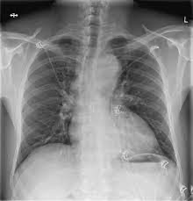
Transferring the interpretable experts and final residual to unseen domain
Semi supervised learning
Pseudo Concepts
Stanford Chexpert
Finetune
MIMIC-CXR
Distilling BB to interpretable experts and residuals
Notes:
\usepackage[dvipsnames]{xcolor}
%Expert 1
\textbf{BayBreastedWarbler} $\leftrightarrow$ \big(\textcolor{blue}{back\_pattern\_striped} $\land$ upperparts\_color\_black $\land$ \textcolor{BrickRed}{wing\_color\_white} $\land$ $\neg$ \textcolor{BrickRed}{nape\_color\_grey} $\land$ $\neg$ throat\_color\_black \big)
$\boldsymbol{\lor}$
\big(belly\_pattern\_solid $\land$ forehead\_color\_black $\land$ \textcolor{BrickRed}{shape\_perchinglike} $\land$ upperparts\_color\_black $\land$ \textcolor{BrickRed}{wing\_color\_white} $\land$ $\neg$\textcolor{BrickRed}{nape\_color\_grey} $\land$
$\neg$\textcolor{BrickRed}{primary\_color\_black} $\land$ $\neg$primary\_color\_white $\land$ $\neg$throat\_color\_black $\land$ $\neg$\textcolor{BrickRed}{under\_tail\_color\_black}\big)
% Expert 2
\textbf{BayBreastedWarbler} $\leftrightarrow$ \textcolor{blue}{back\_pattern\_striped} $\land$ bill\_shape\_allpurpose $\land$ \textcolor{BrickRed}{shape\_perchinglike} $\land$ \textcolor{BrickRed}{wing\_color\_white} $\land$ $\neg$back\_pattern\_multicolored $\land$ $\neg$nape\_color\_black $\land$ $\neg$ nape\_color\_blue $\land$ $\neg$\textcolor{BrickRed}{nape\_color\_grey} $\land$ $\neg$ \textcolor{BrickRed}{primary\_color\_black} $\land$ $\neg$ primary\_color\_grey $\land$ $\neg$\textcolor{BrickRed}{under\_tail\_color\_black}
\text{\textbf{BayBreastedWarbler}} \leftrightarrow & \text{\textcolor{blue}{back\_pattern\_striped}} \hspace{2pt} \land\\
& \text{leg\_color\_grey}
%&\text{\textbf{BayBreastedWarbler}} \\
%&\qquad \qquad \updownarrow \\
%&\text{\textcolor{blue}{back\_pattern\_striped}} \hspace{2pt}\land \\
%&\text{leg\_color\_grey}
% Baseline CBM
%\textbf{BayBreastedWarbler} $\leftrightarrow$ forehead\_color\_black $\land$ leg\_color\_grey $\land$ upper\_tail\_color\_grey $\land$ upperparts\_color\_white
& \quad \qquad \quad \quad \text{\textbf{BayBreastedWarbler}} \leftrightarrow \text{forehead\_color\_black} \hspace{2pt} \land \\
& \qquad \qquad \quad \text{leg\_color\_grey} \hspace{2pt} \land \text{upper\_tail\_color\_grey } \hspace{2pt} \land \\
& \qquad \qquad \quad \text{upperparts\_color\_white}

Slide 7
Notes:
\usepackage[dvipsnames]{xcolor}
%Expert 1
\textbf{BayBreastedWarbler} $\leftrightarrow$ \big(\textcolor{blue}{back\_pattern\_striped} $\land$ upperparts\_color\_black $\land$ \textcolor{BrickRed}{wing\_color\_white} $\land$ $\neg$ \textcolor{BrickRed}{nape\_color\_grey} $\land$ $\neg$ throat\_color\_black \big)
$\boldsymbol{\lor}$
\big(belly\_pattern\_solid $\land$ forehead\_color\_black $\land$ \textcolor{BrickRed}{shape\_perchinglike} $\land$ upperparts\_color\_black $\land$ \textcolor{BrickRed}{wing\_color\_white} $\land$ $\neg$\textcolor{BrickRed}{nape\_color\_grey} $\land$
$\neg$\textcolor{BrickRed}{primary\_color\_black} $\land$ $\neg$primary\_color\_white $\land$ $\neg$throat\_color\_black $\land$ $\neg$\textcolor{BrickRed}{under\_tail\_color\_black}\big)
% Expert 2
\textbf{BayBreastedWarbler} $\leftrightarrow$ \textcolor{blue}{back\_pattern\_striped} $\land$ bill\_shape\_allpurpose $\land$ \textcolor{BrickRed}{shape\_perchinglike} $\land$ \textcolor{BrickRed}{wing\_color\_white} $\land$ $\neg$back\_pattern\_multicolored $\land$ $\neg$nape\_color\_black $\land$ $\neg$ nape\_color\_blue $\land$ $\neg$\textcolor{BrickRed}{nape\_color\_grey} $\land$ $\neg$ \textcolor{BrickRed}{primary\_color\_black} $\land$ $\neg$ primary\_color\_grey $\land$ $\neg$\textcolor{BrickRed}{under\_tail\_color\_black}
\text{\textbf{BayBreastedWarbler}} \leftrightarrow & \text{\textcolor{blue}{back\_pattern\_striped}} \hspace{2pt} \land\\
& \text{leg\_color\_grey}
%&\text{\textbf{BayBreastedWarbler}} \\
%&\qquad \qquad \updownarrow \\
%&\text{\textcolor{blue}{back\_pattern\_striped}} \hspace{2pt}\land \\
%&\text{leg\_color\_grey}
% Baseline CBM
%\textbf{BayBreastedWarbler} $\leftrightarrow$ forehead\_color\_black $\land$ leg\_color\_grey $\land$ upper\_tail\_color\_grey $\land$ upperparts\_color\_white
& \quad \qquad \quad \quad \text{\textbf{BayBreastedWarbler}} \leftrightarrow \text{forehead\_color\_black} \hspace{2pt} \land \\
& \qquad \qquad \quad \text{leg\_color\_grey} \hspace{2pt} \land \text{upper\_tail\_color\_grey } \hspace{2pt} \land \\
& \qquad \qquad \quad \text{upperparts\_color\_white}

Slide 8
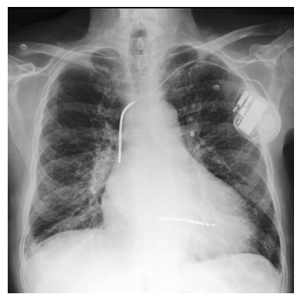
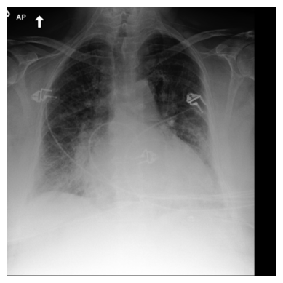
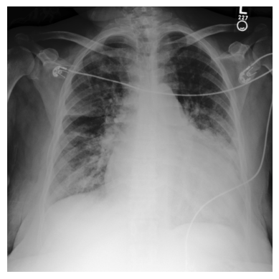
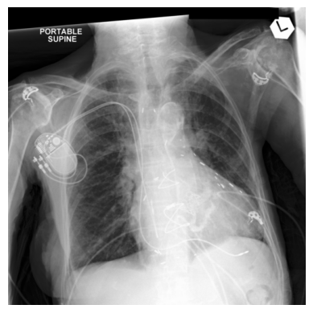
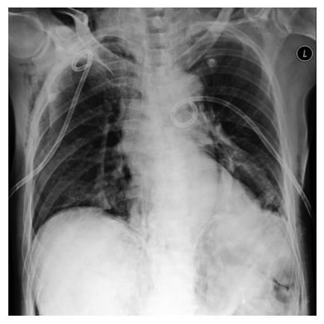
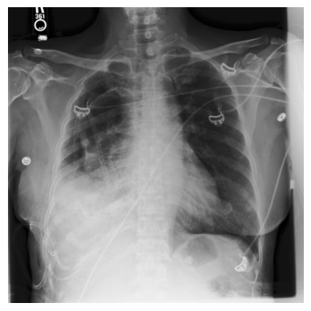
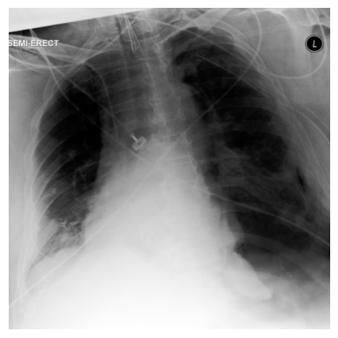
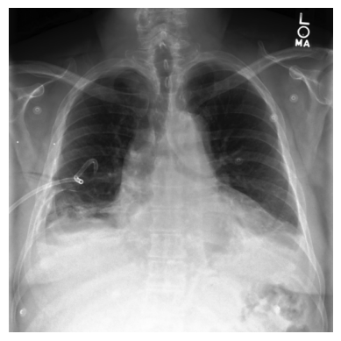
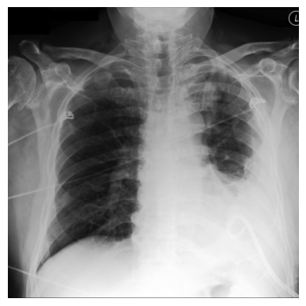
EFFUSION
CBM + ELL
Expert1
Expert2
Expert3
Expert4
PCBM + ELL
MOIE
CARDIOMEGALY
Expert1
Expert2
Expert3
Expert4
CBM + ELL
PCBM + ELL
MOIE
PNEUMOTHORAX
CBM + ELL
Expert1
Expert2
Expert3
Expert4
Expert5
PCBM + ELL
MOIE
Notes:
\usepackage[dvipsnames]{xcolor}
align text
% Effusion
% PCBM
\textbf{Effusion} $\leftrightarrow$ {left\_pleural} $\land$ {pleural\_unspec}
%CBM
\textbf{Effusion} $\leftrightarrow$ \big(collapse $\land$ drainage $\land$ left\_pleural $\land$ pleural\_unpec $\land$ right\_diaphragm $\land$ right\_plural $\land\neg$crowd $\land\neg$ low $\land\neg$ right\_ventricle \big) $\lor$ \big(collapse $\land$ crowd $\land$ drainage $\land$ left\_pleural $\land$ low $\land$ pleural\_unpec $\land$ right\_apical\_lung $\land$ right\_diaphragm $\land$ right\_pleural $\land$ right\_ventricle \big)
% Expert 1
&\text{\textbf{Effusion}} \leftrightarrow \text{left\_pleural} \\
&\land \text{right\_pleural} \\
&\land \text{pleural\_unspec}
% Expert 2
&\text{\textbf{Effusion}} \leftrightarrow \text{right\_pleural} \\
&\land \text{pleural\_unspec}
% Expert 3
&\text{\textbf{Effusion}} \leftrightarrow \text{left\_pleural} \\
&\land \text{pleural\_unspec}
% Expert 4
\textbf{Effusion} $\leftrightarrow$ pleural\_unspec
% cardiomegaly
% CBM
&\text{\textbf{No Cardiomegaly}} \leftrightarrow \text{congestion}
&\text{\textbf{Cardiomegaly}} \leftrightarrow \text{congestion} \\
& \land \text{device} \land \text{edema} \land\neg \text{tip} \land\neg \text{tube}
%PCBM
&\text{\textbf{Cardiomegaly}} \leftrightarrow \big(\text{chf} \land \text{engorgement} \land \text{enlarge}\big) \lor \big(\text{edema} \land \text{engorgement} \\
& \land \text{enlarge} \land \text{heart\_size} \land \neg \text{congestion} \land\neg \text{emphysema} \land\neg \text{spine} \big )
%Expert1
&\text{\textbf{Cardiomegaly}} \leftrightarrow \\
& \text{heart\_size} \\
&\land \text{enlarge}
%Expert 2
&\text{\textbf{Cardiomegaly}} \leftrightarrow \\
&\text{heart\_size} \\
&\land \text{congestion} \\
&\land \text{engorgement}
%Expert 3
&\text{\textbf{Cardiomegaly}} \leftrightarrow \text{chf}\\
& \land \text{enlarge} \land \neg \text{hernia} \\
& \land \text{drainage} \land \neg \text{distention} \\
& \land \text{pressure} \land \text{heart\_size}
% Expert 4
&\text{\textbf{Cardiomegaly}} \leftrightarrow \text{wire}\\
&\text{heart\_size} \land \neg \text{left\_apical\_lung} \\
& \land \text{edema} \land \neg \text{mediastinal} \\
& \land \text{enlarge} \land \neg \text{congestion} \\
& \land \text{disease} \land \text{engorgement}
% CBM
&\text{\textbf{Pneumothorax}} \leftrightarrow \neg\text{emphysema}
% PCBM &\text{\textbf{Pneumothorax}} \leftrightarrow \big(\text{air} \land \text{emphysema} \land \text{right\_apical\_lung}\big) \lor \\
& \big(\text{emphysema} \land \text{right\_apical\_lung} \land \text{left\_apical\_lung}\big) \lor \\
& \big(\text{air} \land \text{drainage} \land \text{right\_apical\_lung} \land \neg\text{left\_apical\_lung} \land \neg\text{lung\_apices}\big) \lor \\
& \big(\text{air} \land \neg \text{right\_apical\_lung} \land \text{left\_apical\_lung} \land \neg\text{lung\_apices} \land \neg \text{emphysema}\big)
&\text{\textbf{Pneumothorax}} \leftrightarrow \\
&\text{left\_apical\_lung}
%Expert1
&\text{\textbf{Pneumothorax}} \leftrightarrow \\
&\text{right\_apical\_lung} \hspace{1.2pt} \land \\
&\text{right\_lung\_unspec}
% Expert2
&\text{\textbf{Pneumothorax}} \leftrightarrow \\
&\text{right\_apical\_lung} \hspace{1.2pt} \land \\
&\text{right\_lung\_unspec}
%Expert3
&\text{\textbf{Pneumothorax}} \leftrightarrow \\
&\text{left\_apical\_lung}
%Expert4
&\text{\textbf{Pneumothorax}} \leftrightarrow \\
&\text{right\_apical\_lung}
%Expert5
&\text{\textbf{Pneumothorax}} \leftrightarrow \\
&\text{emphysema} \hspace{1.5pt} \land \\
&\text{left\_lung\_unspec}

Slide 9
x
CBM + ELL
Expert1
Expert2
Expert3
Expert4
EFFUSION
PCBM + ELL
MOIE
CBM + ELL
Expert1
Expert2
Expert3
Expert4
CARDIOMEGALY
PCBM + ELL
MOIE
PNEUMOTHORAX
CBM + ELL
PCBM + ELL
Expert1
Expert2
Expert3
Expert4
Expert5
MOIE
Notes:
\usepackage[dvipsnames]{xcolor}
align text
% Effusion
% PCBM
\textbf{Effusion} $\leftrightarrow$ {left\_pleural} $\land$ {pleural\_unspec}
%CBM
\textbf{Effusion} $\leftrightarrow$ \big(collapse $\land$ drainage $\land$ left\_pleural $\land$ pleural\_unpec $\land$ right\_diaphragm $\land$ right\_plural $\land\neg$crowd $\land\neg$ low $\land\neg$ right\_ventricle \big) $\lor$ \big(collapse $\land$ crowd $\land$ drainage $\land$ left\_pleural $\land$ low $\land$ pleural\_unpec $\land$ right\_apical\_lung $\land$ right\_diaphragm $\land$ right\_pleural $\land$ right\_ventricle \big)
% Expert 1
&\text{\textbf{Effusion}} \leftrightarrow \\
&\text{left\_pleural} \\
&\land \text{right\_pleural} \\
&\land \text{pleural\_unspec}
% Expert 2
&\text{\textbf{Effusion}} \leftrightarrow \\
& \text{right\_pleural} \\
&\land \text{pleural\_unspec}
% Expert 3
&\text{\textbf{Effusion}} \leftrightarrow \\
& \text{left\_pleural} \\
&\land \text{pleural\_unspec}
% Expert 4
&\text{\textbf{Effusion}} \leftrightarrow \\
&\text{pleural\_unspec}
% cardiomegaly
% CBM
&\text{\textbf{No Cardiomegaly}} \leftrightarrow \text{congestion}
&\text{\textbf{Cardiomegaly}} \leftrightarrow \text{congestion} \\
& \land \text{device} \land \text{edema} \land\neg \text{tip} \land\neg \text{tube}
%PCBM
&\text{\textbf{Cardiomegaly}} \leftrightarrow \big(\text{chf} \land \text{engorgement} \land \text{enlarge}\big) \lor \big(\text{edema} \land \text{engorgement} \\
& \land \text{enlarge} \land \text{heart\_size} \land \neg \text{congestion} \land\neg \text{emphysema} \land\neg \text{spine} \big )
%Expert1
&\text{\textbf{Cardiomegaly}} \leftrightarrow \\
& \text{heart\_size} \\
&\land \text{enlarge}
%Expert 2
&\text{\textbf{Cardiomegaly}} \leftrightarrow \\
&\text{heart\_size} \\
&\land \text{congestion} \\
&\land \text{engorgement}
%Expert 3
&\text{\textbf{Cardiomegaly}} \leftrightarrow \\
& \text{chf} \land \text{enlarge} \\
& \land \neg \text{hernia} \land \text{drainage} \\
& \land \neg \text{distention} \\
& \land \text{pressure} \land \text{heart\_size}
% Expert 4
&\text{\textbf{Cardiomegaly}} \leftrightarrow \text{wire}\\
&\text{heart\_size} \land \neg \text{left\_apical\_lung} \\
& \land \text{edema} \land \neg \text{mediastinal} \\
& \land \text{enlarge} \land \neg \text{congestion} \\
& \land \text{disease} \land \text{engorgement}
% CBM
&\text{\textbf{Pneumothorax}} \leftrightarrow \neg\text{emphysema}
% PCBM &\text{\textbf{Pneumothorax}} \leftrightarrow \big(\text{air} \land \text{emphysema} \land \text{right\_apical\_lung}\big) \lor \\
& \big(\text{emphysema} \land \text{right\_apical\_lung} \land \text{left\_apical\_lung}\big) \lor \\
& \big(\text{air} \land \text{drainage} \land \text{right\_apical\_lung} \land \neg\text{left\_apical\_lung} \land \neg\text{lung\_apices}\big) \lor \\
& \big(\text{air} \land \neg \text{right\_apical\_lung} \land \text{left\_apical\_lung} \land \neg\text{lung\_apices} \land \neg \text{emphysema}\big)
&\text{\textbf{Pneumothorax}} \leftrightarrow \\
&\text{left\_apical\_lung}
%Expert1
&\text{\textbf{Pneumothorax}} \\
&\leftrightarrow \text{right\_apical\_lung} \\
&\land \text{right\_lung\_unspec}
% Expert2
&\text{\textbf{Pneumothorax}} \\
&\leftrightarrow \text{right\_apical\_lung} \\
&\land \text{right\_lung\_unspec}
%Expert3
&\text{\textbf{Pneumothorax}} \\
&\leftrightarrow \text{left\_apical\_lung}
%Expert4
&\text{\textbf{Pneumothorax}} \\
&\leftrightarrow \text{right\_apical\_lung}
%Expert5
&\text{\textbf{Pneumothorax}} \\
&\leftrightarrow \text{emphysema} \\
& \land \text{left\_lung\_unspec}

Slide 10
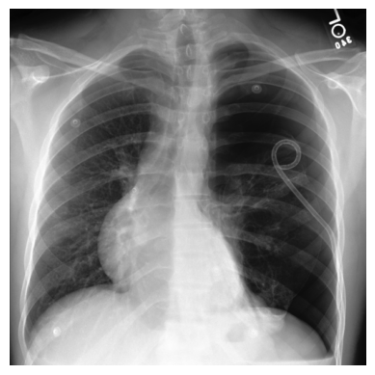
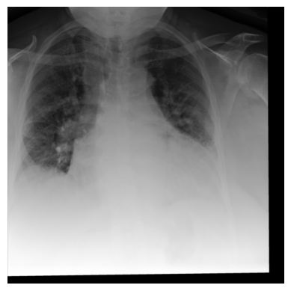
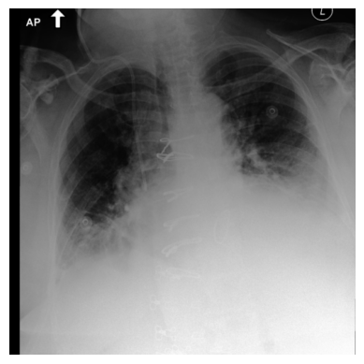
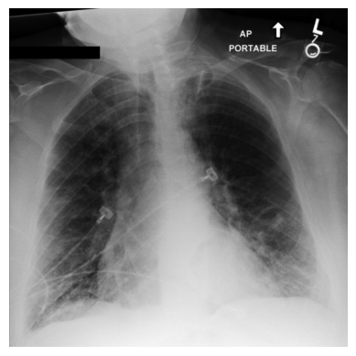
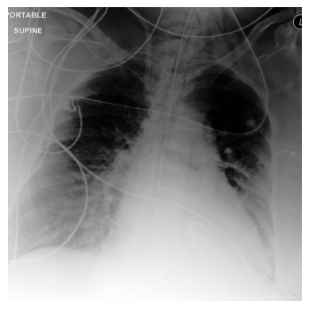
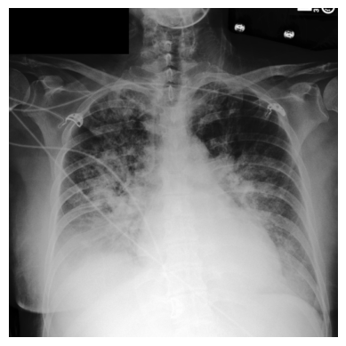
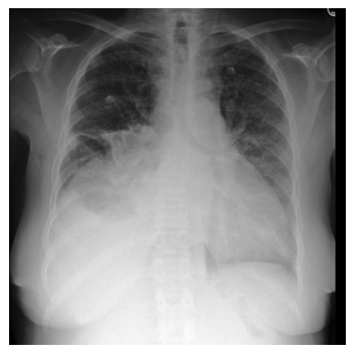
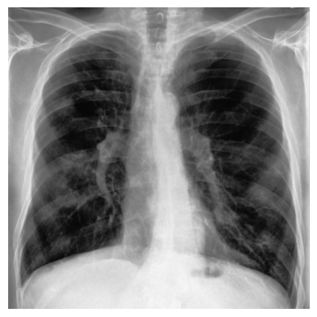
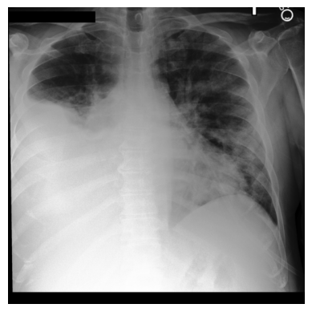
CBM + ELL
Expert1
Expert2
Expert3
Expert4
Expert5
PCBM + ELL
MOIE
EDEMA
PNEUMONIA
CBM + ELL
Expert1
Expert2
Expert3
Expert4
PCBM + ELL
MOIE
Notes:
\usepackage[dvipsnames]{xcolor}
align text
% Edema
% PCBM
&\text{\textbf{Edema}} \leftrightarrow \big(\text{right\_pleural} \land \text{pleural\_unspec} \land \text{right\_diaphragm} \land \text{retrocardiac} \land \neg\text{left\_apical\_lung} \land \neg \text{lung\_bases} \\
&\land\text{interstitium} \land \text{parenchymal} \land \neg \text{effusion} \land \neg\text{tube}\land \text{process} \land \text{congestion} \land \neg \text{disease}\land \neg\text{calcification}\\
&\land \text{engorgement}\land\neg\text{elevation} \land\neg\text{degenerative}\land\neg\text{scar}\land\neg \text{emphysema} \land \neg \text{hernia} \land \text{pressure} \land \text{chf} \\
&\land \text{redistribution}
\big) \lor \big(\text{pleural\_unspec} \land \neg\text{right\_diaphragm} \land\text{interstitium} \land \neg \text{stomach} \land \text{effusion} \land \text{process} \\
&\land \text{congestion} \land \text{engorgement}\land\neg\text{elevation} \land\neg\text{degenerative}\land\neg\text{scar}\land\neg \text{emphysema} \land \neg \land \text{chf} \\
&\land \text{redistribution}
\big) \lor \big(\text{pleural\_unspec} \land \neg \text{right\_diaphragm} \land \neg \text{retrocardiac} \land\text{interstitium} \land \neg \text{stomach} \\
&\land \text{effusion} \land \text{tube}\land \neg \text{process} \land \text{congestion} \land \text{engorgement} \land\neg\text{elevation} \land\neg\text{degenerative} \land\neg\text{scar} \\
& \land\neg \text{emphysema} \land \text{pressure} \land \text{chf} \land \text{redistribution}
\big) \lor \big(\neg \text{right\_pleural} \land \text{pleural\_unspec} \land \neg \text{right\_diaphragm} \\
&\land \neg \text{retrocardiac} \land \neg\text{left\_apical\_lung} \land \text{right\_lower\_lung}\land \text{lung\_bases} \land\text{interstitium} \land \text{parenchymal} \land \neg \text{stomach}\\
& \land \text{effusion} \land \neg\text{tube}\land \text{process} \land \text{abnormality} \land \text{congestion} \land \text{cardiomegaly} \land \text{disease}\land \neg\text{calcification}\\
&\land \text{engorgement}\land\neg\text{elevation} \land\neg\text{degenerative}\land\neg\text{scar}\land\neg \text{emphysema} \land \neg \text{hernia} \land \text{pressure} \land \text{chf} \\
&\land \text{redistribution}
\big) \lor \big(\text{right\_pleural} \land \text{pleural\_unspec} \land \neg\text{right\_diaphragm} \land \text{retrocardiac} \land \neg\text{left\_apical\_lung} \\
& \land \text{right\_lower\_lung} \land \neg \text{lung\_bases} \land\text{interstitium} \land \text{parenchymal} \land \neg \text{stomach} \land \text{effusion} \land \text{tube} \\
&\land \text{process} \land \text{abnormality} \land \text{line} \land \text{congestion} \land \text{cardiomegaly} \land \text{disease}\land \neg\text{calcification}\\
&\land \text{engorgement}\land\neg\text{elevation} \land\neg\text{degenerative} \land\neg \text{scar} \land\neg \text{emphysema} \land \neg \text{hernia} \land \text{pressure} \land \text{chf} \\
&\land \neg\text{redistribution}
\big)
%CBM
&\text{\textbf{No Edema}} \leftrightarrow \neg \text{effusion}
&\text{\textbf{Edema}} \leftrightarrow \text{cardiomegaly} \land \\
&\text{chf} \land \text{congestion} \land \text{effusion}
% Expert 1
&\text{\textbf{Edema}} \leftrightarrow \text{heart\_size} \\
& \land \text{right\_diaphragm} \\
& \land \neg \text{left\_lung\_unspec} \\
& \land \neg \text{lung\_bases} \\
& \land \neg \text{interstitium} \\
& \land \text{parenchymal} \land \neg \text{scar} \\
& \land \neg \text {stomach} \land \neg \text{low} \\
& \land \text{catheter} \land \neg \text{line} \\
& \land \text{engorgement} \\
& \land \neg \text{elevation} \land \neg\text{wire} \\
&\land \text{widen} \land \text{infiltrate} \\
& \land \neg \text{emphysema} \\
& \land \neg \text{deformity}\neg \text {hernia}
% Expert 2
&\text{\textbf{Edema}} \leftrightarrow \\
& \text{interstitium} \\
& \land \text{congestion} \\
& \land \text{chf}
% Expert 3
&\text{\textbf{Edema}} \leftrightarrow \text{hilar\_unspec} \\
&\land \text{left\_pleural} \land \text{right\_pleural} \\
&\land \text{heart\_size} \land \neg \text{retrocardiac} \\
& \land \neg \text{left\_apical\_lung} \land \neg \text{hernia}\\
&\land \text{left\_lung\_unspec} \\
&\land \neg \text{right\_lower\_lung} \\
& \land \text{lung\_bases} \land \neg \text{shift}\\
& \land \text{mediastinal} \land \text{interstitium} \\
& \land \text {right\_atrium} \land \neg \text{arota} \\
& \land \neg \text{parenchymal} \land \neg \text{low}\\
& \land \text{effusion} \land \neg \text{process}\\
& \land \text{consolidation} \land \neg \text{emphysema} \\
& \land \text{abnormality} \land \text{congestion} \\
& \land \text{cardiomegaly} \land \neg \text{tortuous} \\
& \land \neg \text{disease} \land \neg \text{scar} \\
& \land \neg \text{infiltrate} \land \neg \text{distention}
% Expert 4
&\text{\textbf{Edema}} \leftrightarrow \text{hilar\_unspec} \\
&\land \neg \text{left\_pleural} \land \neg \text{air} \\
&\land \neg \text{left\_diaphragm} \\
&\land \text{right\_lung\_unspec} \\
& \land \text{interstitium} \\
& \land \text{parenchymal}\\
& \land \text{process} \land \text{disease} \\
& \land \text{congestion} \\
& \land \neg \text{wire} \land \neg \text{scar} \\
& \land \text{infiltrate} \land \neg \text{widen}\\
& \land \neg \text{deformity} \land \neg \text{hernia} \\
& \land \text{chf} \land \neg \text{aspiration}
% Expert 5
&\text{\textbf{Edema}} \leftrightarrow \neg \text{hilar\_unspec} \\
&\land \text{left\_pleural} \land \text{pleural\_unspec} \\
&\land \text{heart\_size} \land \neg \text{svc} \\
& \land \neg \text{right\_lower\_lung} \\
&\land \text{lung\_bases} \\
&\land \neg \text{right\_atrium} \\
& \land \text{right\_ventricle}\\
& \land \text{interstitium} \\
& \land \text{parenchymal} \\
& \land \neg \text{stomach} \\
& \land \text{effusion} \\
& \land \text{tube} \land \text{chf} \\
& \land \text{process} \\
& \land \text{enlarge} \land \text{catheter} \\
& \land \text{cardiomegaly} \\
& \land \neg \text{emphysema}\\
& \land \neg \text{air} \land \neg \text{lead} \\
& \land \text{disease} \land \text{device} \\
& \land \neg \text{wire} \land \neg \text{scar} \\
& \land \text{widen} \land \neg \text{emphysema} \\
& \land \neg \text{hernia} \land \neg \text{drainage} \\
& \land \neg \text{distention} \\
% Pneumonia
% CBM
&\text{\textbf{No Pneumonia}} \leftrightarrow \text{right\_diphragm}
%PCBM
&\text{\textbf{No Pneumonia}} \leftrightarrow \neg \text{consolidation}
%Expert1
&\text{\textbf{Pneumonia}} \leftrightarrow \\
& \text{opacity} \hspace{1.2pt} \land \\
& \text{consolidation}
%Expert 2
&\text{\textbf{Pneumonia}} \leftrightarrow \\
& \text{opacity}
%Expert 3
&\text{\textbf{Pneumonia}} \leftrightarrow \\
& \text{consolidation}
% Expert 4
&\text{\textbf{Pneumonia}} \leftrightarrow \\
& \text{opacity}

Slide 11
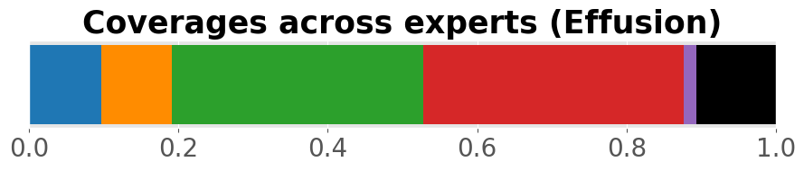
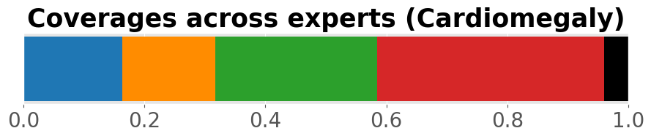
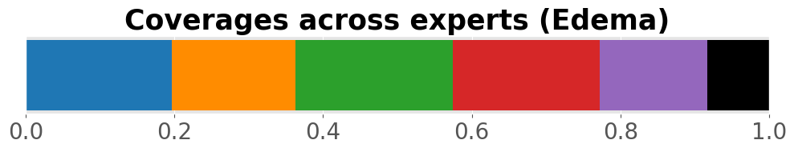
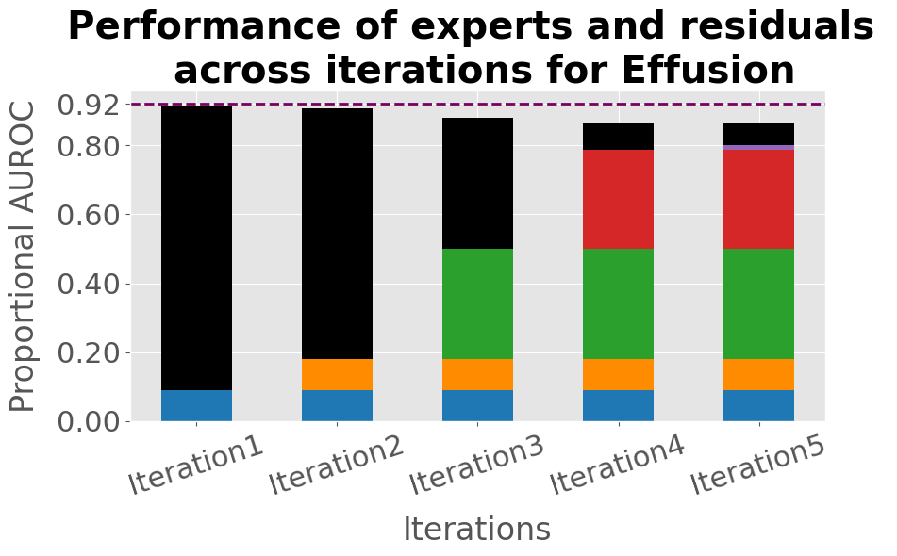
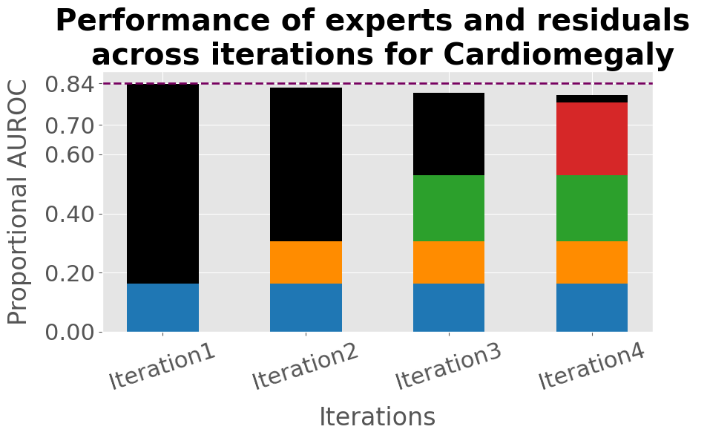
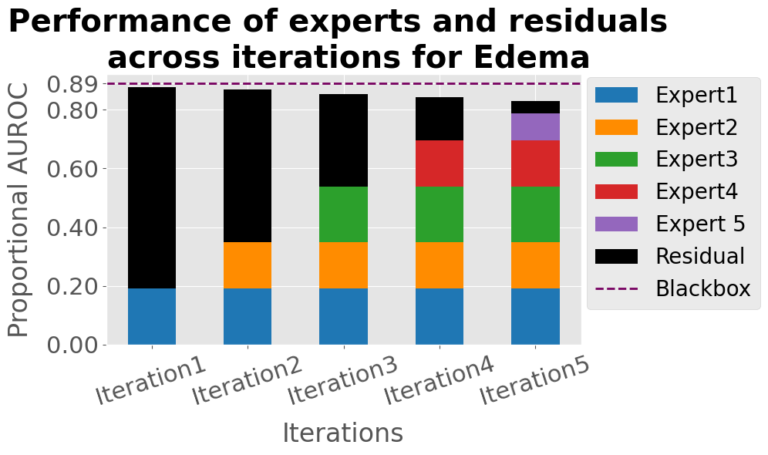
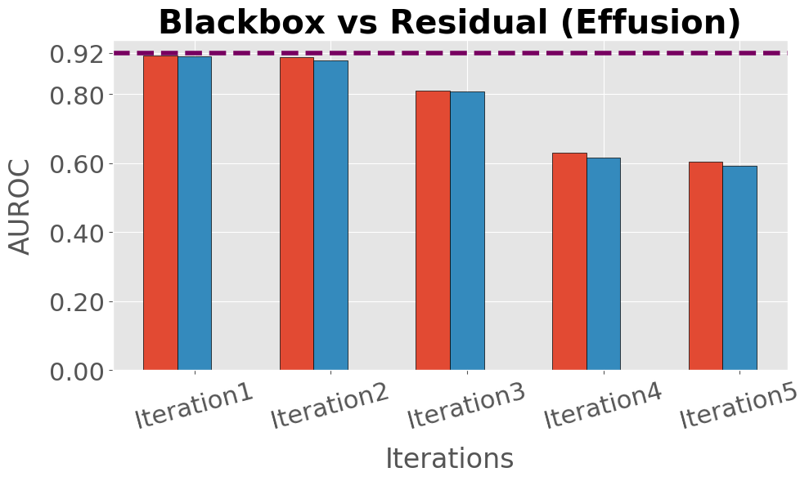
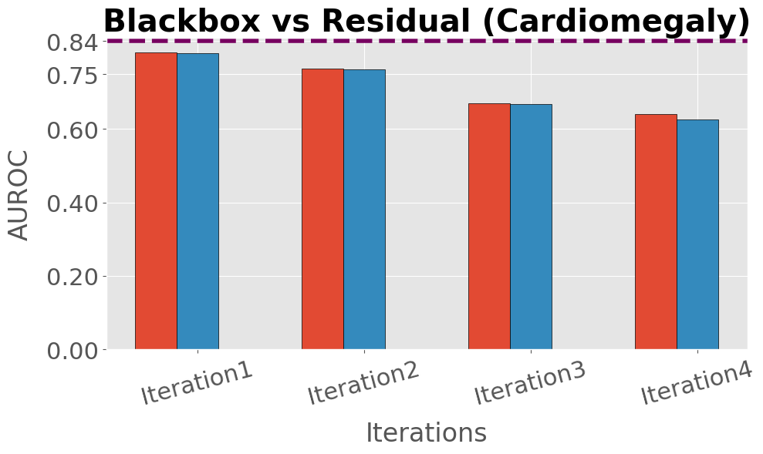
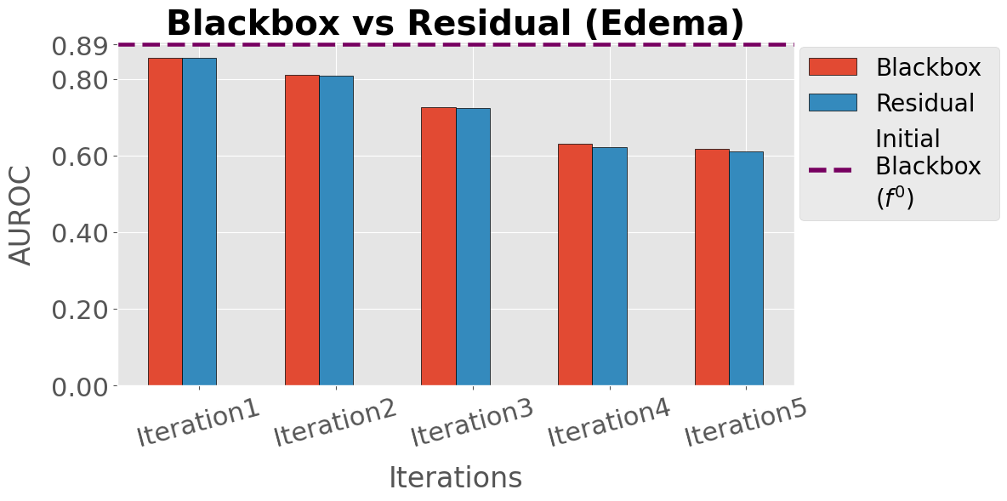
(a)
(b)
(c)
(d)
(e)
(f)

Slide 12
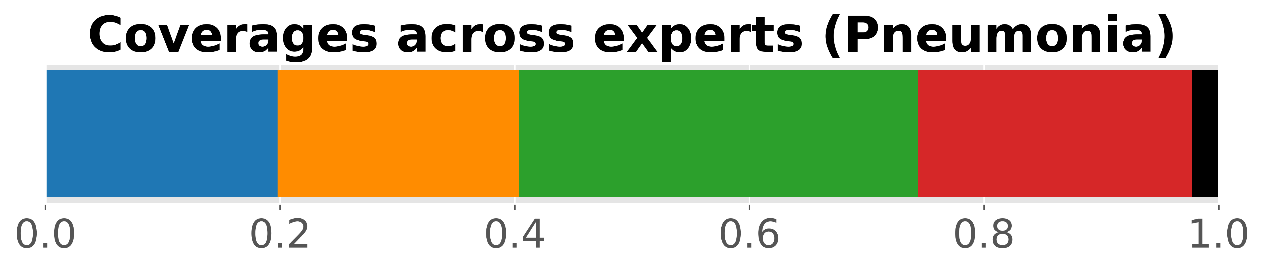
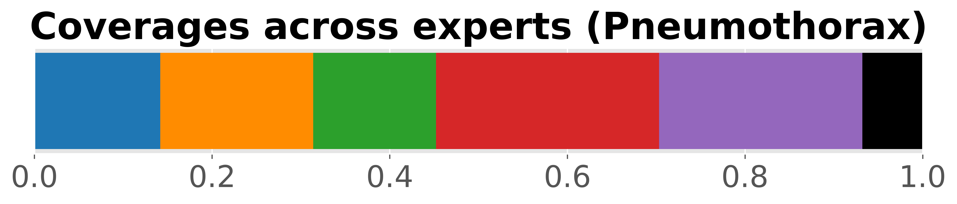
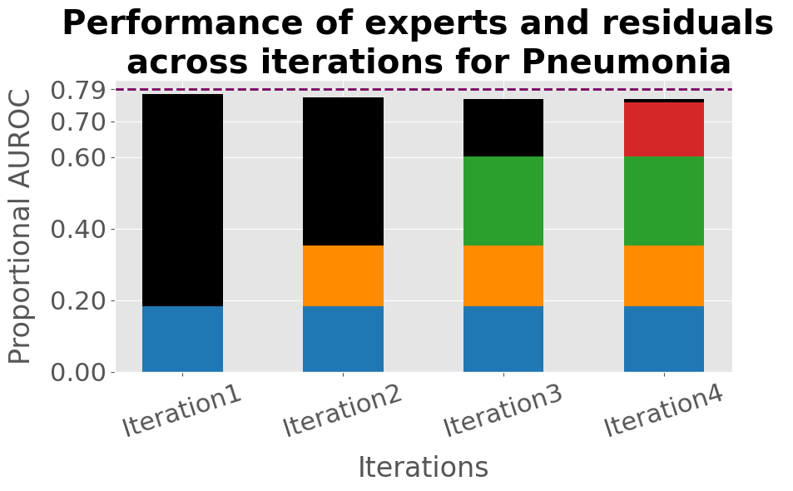
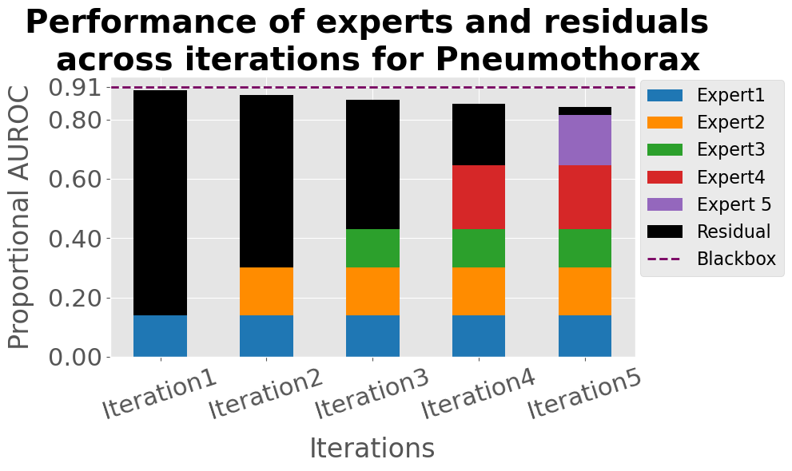
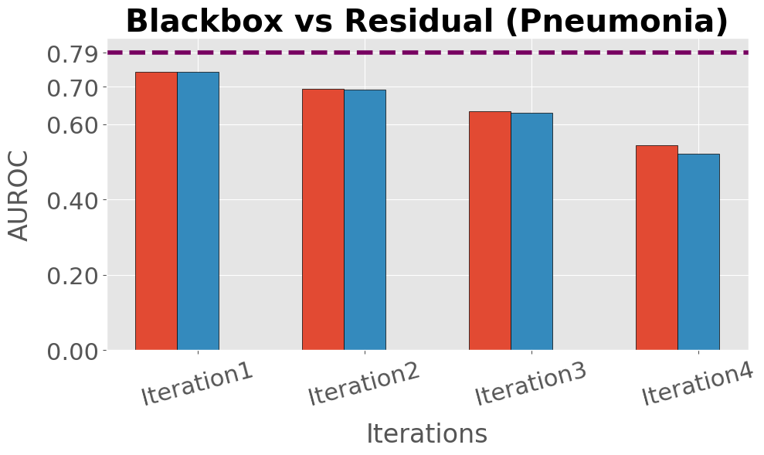
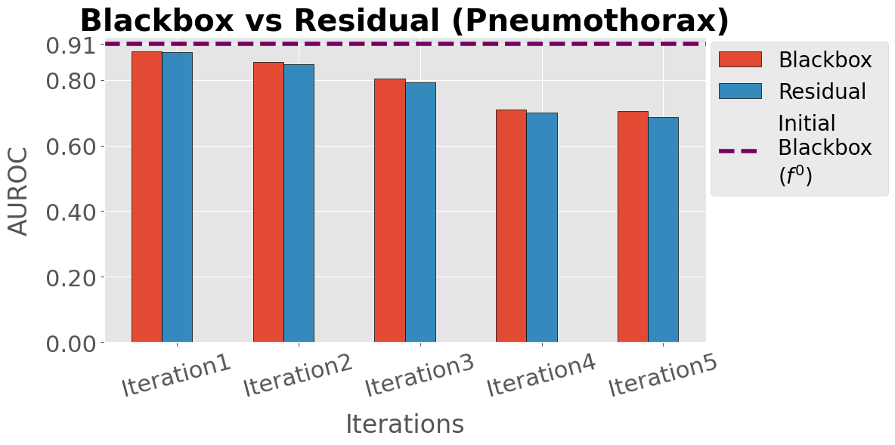
(a)
(b)
(c)
(d)

Slide 13
(a)
(b)
(c)
(d)
(e)
(f)

Slide 14
(a)
(b)
(c)
(d)

Slide 15
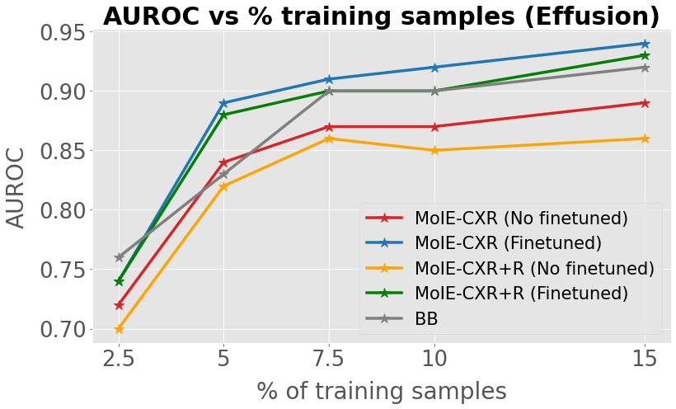
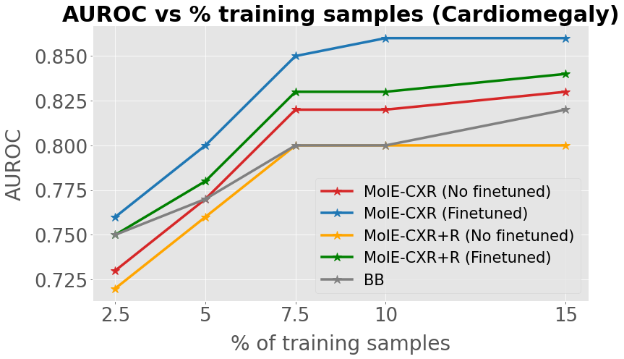
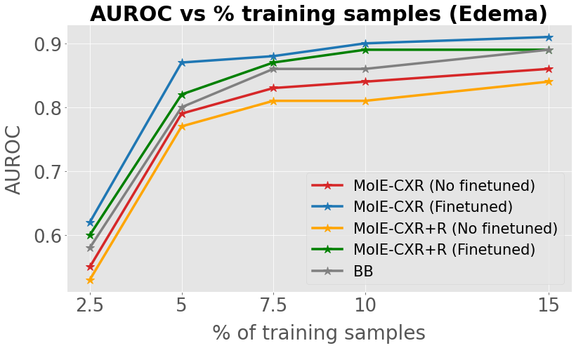



(a)
(b)
(c)
(d)
(e)
(f)

